Slide 1

LINEAR PROBING – GET
AND INSERT
divisor = b (number of buckets) = 17.
Home bucket = key % 17.
0
4
8
12
16
34
0
45
6
23
7
28
12
29
11
30
33
Insert pairs whose keys are 6, 12, 34, 29, 28, 11, 23, 7, 0, 33, 30, 45

Slide 2
LINEAR PROBING – DELETE
6, 12, 34, 29, 28, 11, 23, 7, 0, 33, 30, 45
0
4
8
12
16
34
0
45
6
23
7
28
12
29
11
30
33
Delete(0)
0
4
8
12
16
34
45
6
23
7
28
12
29
11
30
33
Search cluster for pair (if any) to fill vacated bucket.
0
4
8
12
16
34
45
6
23
7
28
12
29
11
30
33

Slide 3
LINEAR PROBING – DELETE(34)
0
4
8
12
16
34
0
45
6
23
7
28
12
29
11
30
33
0
4
8
12
16
0
45
6
23
7
28
12
29
11
30
33
Search cluster for pair (if any) to fill vacated bucket.
0
4
8
12
16
0
45
6
23
7
28
12
29
11
30
33
0
4
8
12
16
0
45
6
23
7
28
12
29
11
30
33

Slide 4
LINEAR PROBING – DELETE(29)
0
4
8
12
16
34
0
45
6
23
7
28
12
29
11
30
33
0
4
8
12
16
34
0
45
6
23
7
28
12
11
30
33
Search cluster for pair (if any) to fill vacated bucket.
0
4
8
12
16
34
0
45
6
23
7
28
12
11
30
33
0
4
8
12
16
34
0
45
6
23
7
28
12
11
30
33
0
4
8
12
16
34
0
6
23
7
28
12
11
30
45
33

Slide 5

PERFORMANCE OF
LINEAR PROBING
0
4
8
12
16
34
0
45
6
23
7
28
12
29
11
30
33
Worst-case find/insert/erase time is Θ(n), where n is the number of pairs in the table.
This happens when all pairs are in the same cluster.

Slide 6

EXPECTED PERFORMANCE
0
4
8
12
16
34
0
45
6
23
7
28
12
29
11
30
33
α = loading density = (number of pairs)/b.
  α = 12/17.
S_{n} = expected number of buckets examined in a successful search when n is large
U_{n} = expected number of buckets examined in a unsuccessful search when n is large
Time to put and remove is governed by U_{n}.
Notes:
A put that increases the number of pairs in the table involves an unsuccessful search followed by the addition of an element. An unsuccessful remove is essentially an unsuccessful search. A successful remove must also go to the end of the cluster and so is like an unsuccessful search.

Slide 7
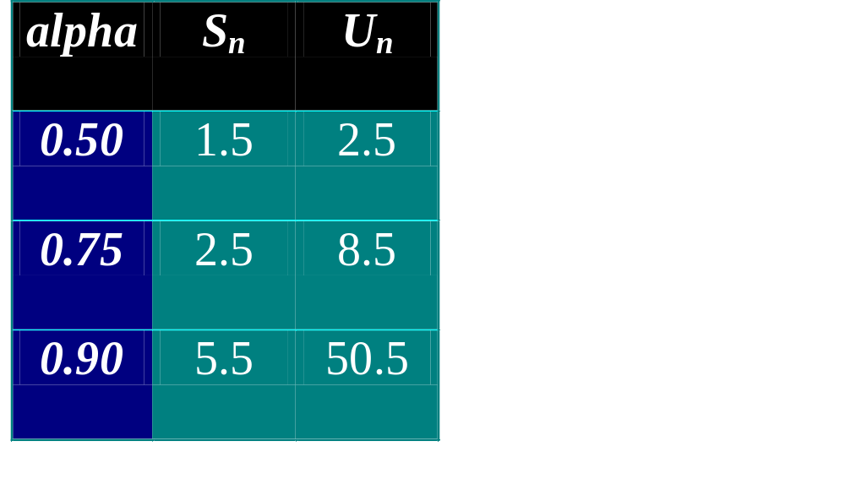
EXPECTED
PERFORMANCE
S_{n} ~ ½(1 + 1/(1 – α))
U_{n} ~ ½(1 + 1/(1 – α)²)
Note that 0 <= α <= 1.
The proof refers to D. Knuth’s TAOCP vol. III
α <= 0.75 is recommended.

Slide 8
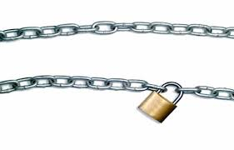
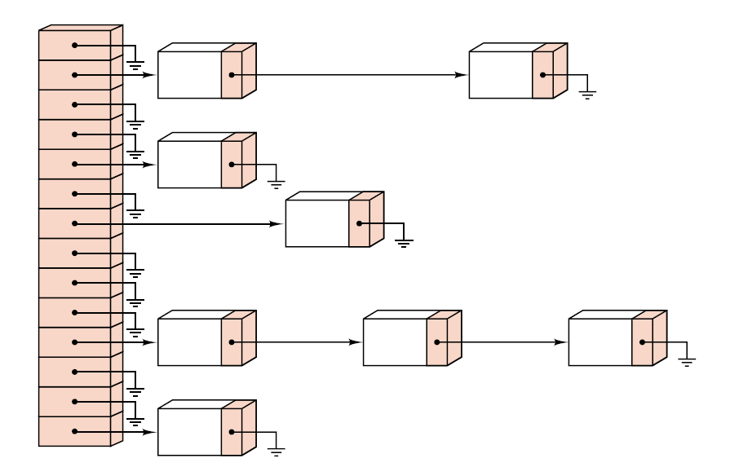
FIGURE OF CHAINING

Slide 9

SORTED CHAINS
[0]
0
34
[4]
Put in pairs whose keys are 6, 12, 34, 29, 28, 11, 23, 7, 0, 33, 30, 45
Bucket = key % 17.
6
23
7
[8]
11
28
45
[12]
12
29
30
[16]
33

Slide 10
EXPECTED PERFORMANCE
Note that α >= 0.
Expected chain length is α.
S_{n} ~ 1 + α/2.
U_{n} ~ α

Slide 11

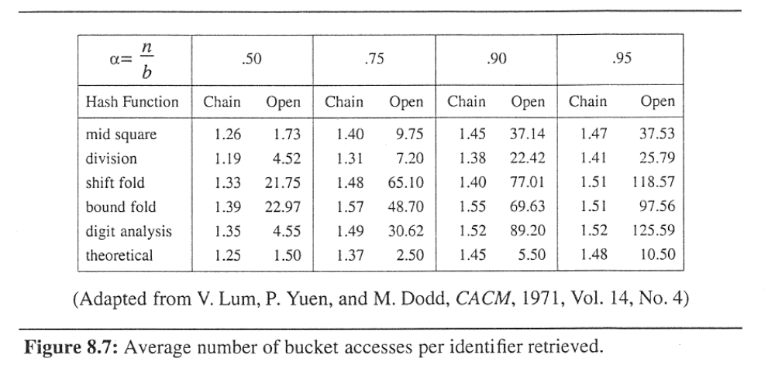
COMPARISON

Slide 12
Extendible Hashing
Combines features of
  Hashing
  Multi-way tries
  Sequential-access
Uses just one or two probes for insert or search

Slide 13
Extendible Hashing
Search
  Start with leading bits of key
  Index into table (power of 2 size)
Items stored in buckets split when overflow
Maintain directory with reference to buckets containing item matching a key

Slide 14
Extendible Hashing
Suppose have 2^{d} buckets
  Directory of 2^{d} buckets references
  Use d bits of key to index into directory
  Keep in same buckets all keys whose first d bits match, in order
  Sequential search on buckets
  OK to have many pointers to same bkt
  Items stored in bkt split when overflow

Slide 15
Extendible Hashing
Defn. : An extendible hash table of order d is a directory of 2^{d} references to buckets that each contain up to M items with keys(slots). The items on each buckets are identical in their first k bits, and the directory contains 2^{d-k} pointers to the buckets , starting at the location specified by the first k bits on the page.

Slide 16
Extendible Hashing
Table growth
buckets split
  Distribute keys from one buckets over two
  Decided by first bit where keys differ
Directory split
  Double the size of the directory, d++
  Do when necessary from buckets split
  May make multiple pointers to same buckets

Slide 17
Extendible Hashing
Prop. : The extendible hash table built from a set of keys depends only on the values of those keys, not upon their insertion order.

Slide 18
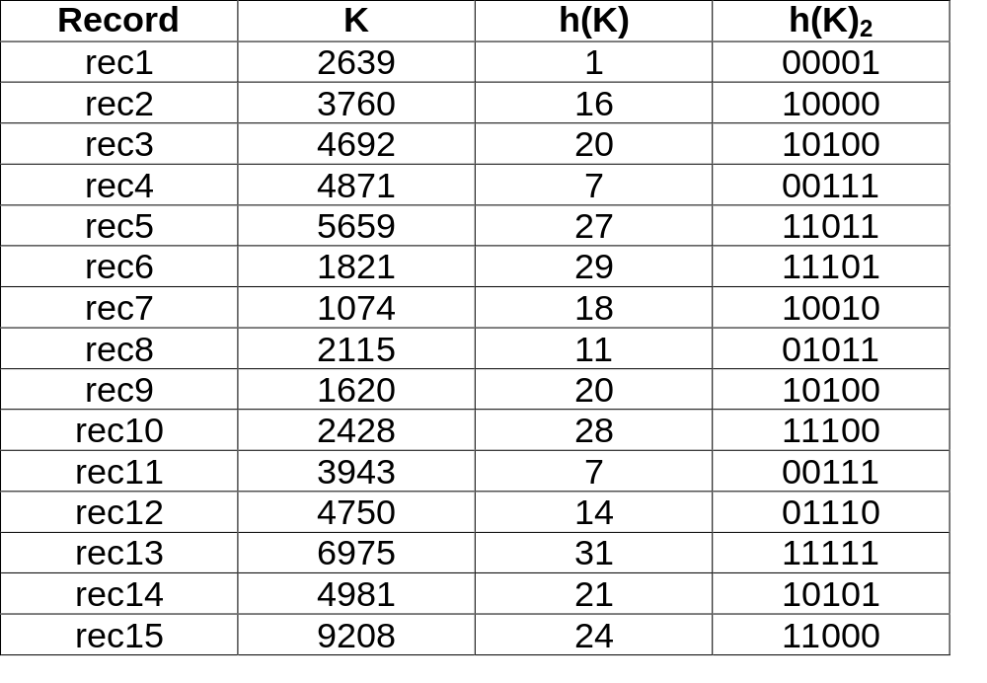
EXTENDIBLE HASHING - CLASS EXAMPLE

Slide 19
d¹ = local depth
d = global depth
rec 1
d1 = 1
rec 4
splitting bucket
rec 1
d¹=0
0
splitting bucket
rec 2
1
d = 0
d = 1
record 3 = overflow!!
rec 2
d1 = 1
rec 3
record 5 = overflow!!
NEXT

Slide 20
rec 1
d1 = 1
rec 4
00
01
rec 2
d1 = 2
10
splitting bucket
rec 3
record 7 = overflow!!
11
d = 2
rec 5
d1 = 2
rec 6
NEXT

Slide 21
rec 1
d1 = 1
splitting bucket
rec 4
record 8 = overflow!!
000
001
rec 2
d1 = 3
010
rec 7
011
rec 3
d1 = 3
100
101
110
111
rec 5
d1 = 2
d = 3
rec 6
NEXT

Slide 22
rec 1
d1 = 3
NEXT
rec 4
d1 = 3
rec 8
d1 = 2
000
001
010
011
100
rec 2
d1 = 3
101
rec 7
110
rec 3
d1 = 3
111
rec 9
d = 3
rec 5
d1 = 2
splitting bucket
rec 6
record 10 = overflow!!

Slide 23
NEXT
rec 1
d1 = 3
rec 4
d1 = 3
rec 11
rec 8
d1 = 2
000
rec 12
001
010
011
100
rec 2
d1 = 3
101
rec 7
110
rec 3
d1 = 3
111
rec 9
d = 3
rec 5
d1 = 3
rec 6
d1 = 3
splitting bucket
rec 10
record 13 = overflow!!

Slide 24
rec 1
d1 = 3
0000
0001
rec 4
d1 = 3
0010
rec 11
0011
rec 8
d1 = 2
0100
rec 12
0101
0110
rec 2
d1 = 3
0111
rec 7
1000
rec 3
d1 = 3
1001
rec 14
1010
rec 5
d1 = 3
1011
rec 15
1100
1101
rec 6
d1 = 4
1110
rec 10
1111
rec 13
d1 = 4
d = 4

Slide 25
Extendible Hashing
M = 5 keys + item references per page
Insert:
601
153
513
706
176
773
601
153
601
513
176
601
513
706
601
706
Now what? The page is full!
Split!

Slide 26
Extendible Hashing
Split page, so split directory…
Insert:
601
153
513
706
176
773
742
373
524
0x
153
176
373
1x
513
601
706
773
742
773
Now we can insert 773

Slide 27
Extendible Hashing
Split page again, need to split directory…
153
Insert:
…
524
776
275
374
007
00x
176
373
275
01x
373
374
10x
513
601
524
11x
706
742
773
776
Now we can insert 524
Now what?

Slide 28
Extendible Hashing
Split page …
but no need to split directory
(2 pointers)
153
Insert:
…
007
007
275
00x
176
153
373
176
374
374
01x
10x
513
601
524
11x
706
742
773
776
Now we can insert 007

Slide 29
Extendible Hashing
Split page again, need to split directory…
153
Insert:
…
524
776
275
737
00x
176
373
275
01x
373
10x
513
601
524
11x
706
742
773
773
773
776
Now we can insert 524

